Slide 1
Sports
Lilja x2, Iiris, Elsa ja Liisa
Iina, Timo ja Ville

Slide 2
Legal basis
Sports have always been a significant part of culture in Europe
It is a new field the for the European Union to support sports
The first treaties for supporting sports were made in 2007
In addition, EU supports by financing for Sport Erasmus+ projects and by pursuing fairness and equality in sports.

Slide 3
Objectives
The EU objective is review sporting from three points, which are:
The societal role of sport.
The economic dimension of sport.
The political and legal framework of the sport sector.
In addition EU works to attain greater fairness and openness in sport competitions and greater protection of the moral and physical integrity of sportspeople.

Slide 4
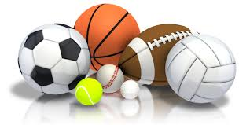
Policy developments
1. White Paper on sports and the Pierre de Coubertin action plan
White paper was the first comprehensive initiative on sport by the EU and it was made in july 2007.
White paper’s goals in sport: enhancing the societal role of sport and promoting public health through physical activity, boosting volunteer activities, fighting doping, and controlling media rights

Slide 5
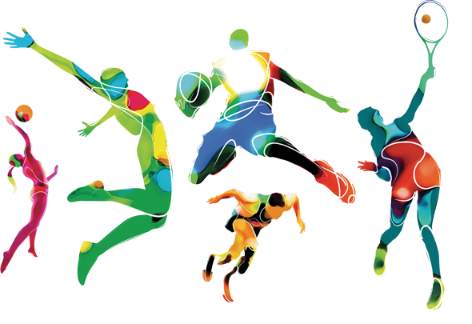
2. Developing the European dimension in sport
Developing the European Dimension in sport was made in 2011. This was the first policy document from the commission to sport since the Lisbon treaty. The developing document includes goals for europe 2020 about the impact of sport:
recognising that sport improves employability and promotes social inclusion
develop of security arrangements and safety requirements for international sport events
3. EU Work Plans for Sport
EU wants to develop: anti-doping, safe-guarding of minors, good governance, coaches and sport diplomacy

Slide 6
Action programmes
Erasmus +
Sports are one of the most important parts of Erasmus+ projects. Erasmus+ consists of the EU programme for education, training, youth and sport.
The annual budget of Erasmus+ for sport is 1.8%. (for supporting partnerships, European sports events and supports relevant European stakeholders).
European Week of Sport
The European Week of sport has been organized since 2012 in order to encourage European citizens to increase the physical activity and at the same support Erasmus +.
Eurobarometer survey showed that 59% of Europeans sometimes or never exercise. As a result, people’s health is falling.
Effect
- Sports can affect to many things:
Fight against racism and xenophobia
Bring people together
Building communities
The integration of migrants in EU

Slide 7
Role of the European Parliament
European sports policy is a part of Committee on Culture and Education CULT
It made a report on the European dimension in sport in 2012 which was start to European Week of Sport (1st. time in 2015). It was aimed at having new activites and bringing up initiativity in Europe in national, areal and local context
European Parliament acknowledges that EU has to deal with sports matters
Sports are “an important social phenomeon and a public good”.
One of the Parliament’s objectives is to commit in reaffirming social importance of sports
Parliament recognizes the importance of sports for tourism
It’s trying to make important sporting places more attractive to tourists
Parliament has been fighting against match-fixing and corruption. It has made a decision to integrate approach to Sport Policy

Slide 8
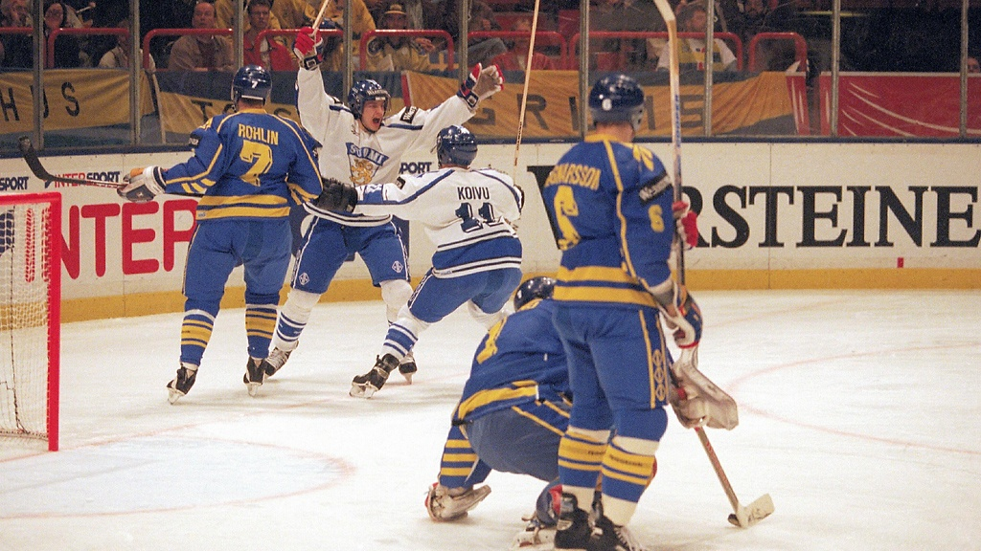
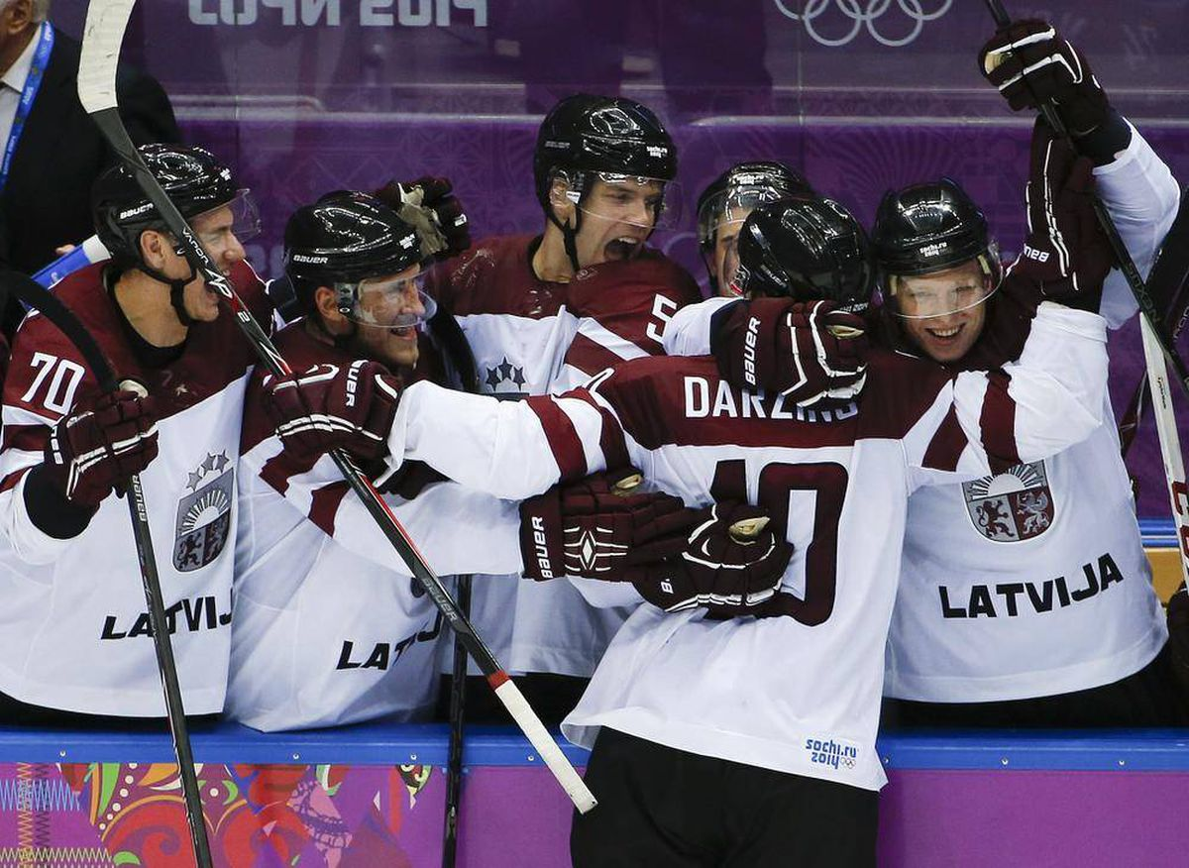
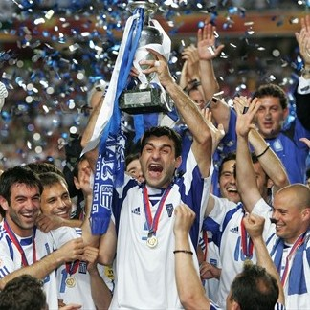
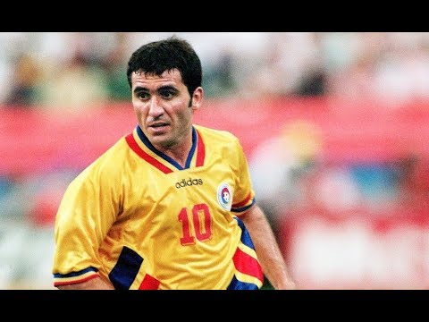
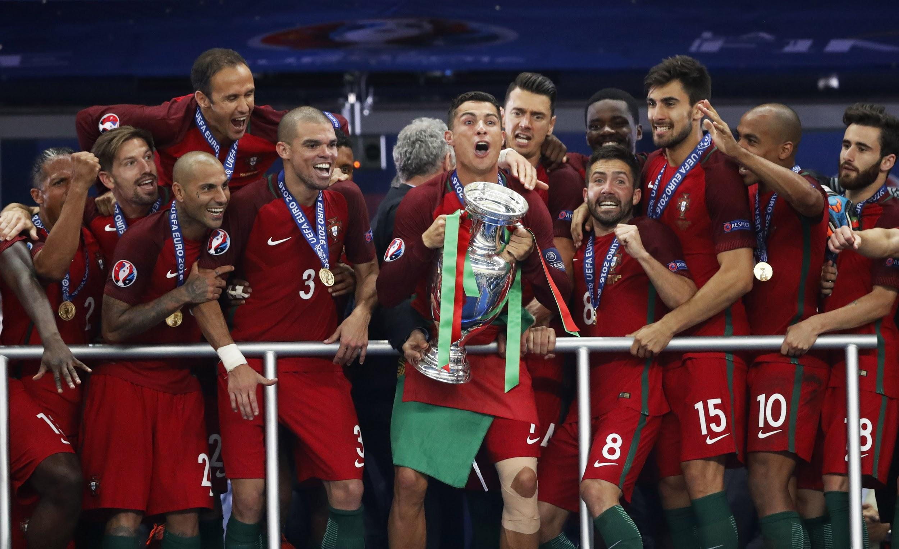
Sport and Identity

Slide 9
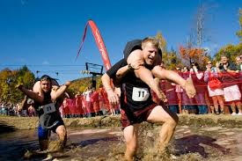
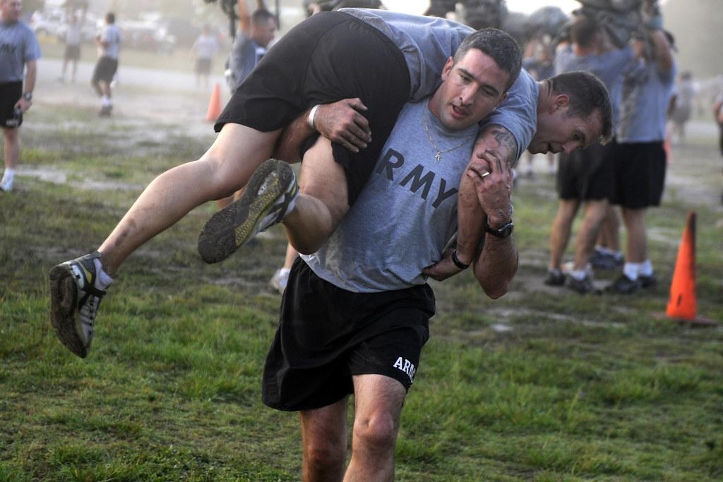
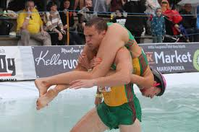
EUKONKANTO
EUKONKANTO
https://youtu.be/p7IM9f16QZ4

Slide 10
https://create.kahoot.it/login
https://kahoot.it/

Slide 11
Thank you!
http://www.europarl.europa.eu/factsheets/en/sheet/143/sport

